Slide 1
Electricity and Chemistry: Electrolysis

Slide 2
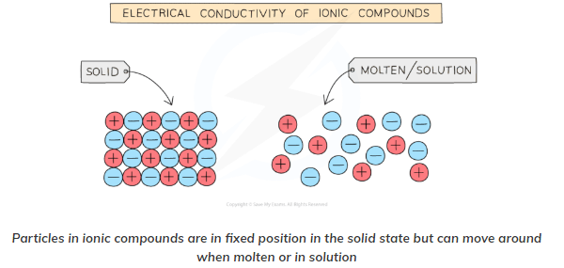
Electrolysis
When an electric current is passed through a molten ionic compound the compound decomposes or breaks down.
The process also occurs for aqueous solutions of ionic compounds.
Covalent compounds cannot conduct electricity hence they do not undergo electrolysis.
Ionic compounds in the solid state cannot conduct electricity either since they have no free ions that can move and carry the charge.

Slide 3
What Is Electrolysis?
Electrolysis is a way of separating a compound by passing an electric current through it; the products are the compound’s component ions.
The main components required to achieve electrolysis are:
An electrolyte: a substance containing free ions, which are the carriers of electric current in the electrolyte. If the ions are not mobile, as in a solid salt, then electrolysis cannot occur.
A direct current (DC) supply: provides the energy necessary to create or discharge the ions in the electrolyte. Electric current is carried by electrons in the external circuit.
Two electrodes: an electrical conductor that provides the physical interface between the electrical circuit providing the energy and the electrolyte.

Slide 4
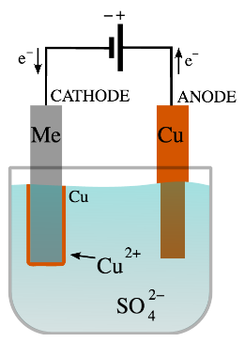
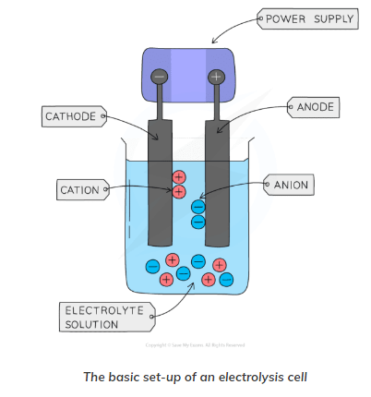

Slide 5
Electrode is a rod of metal or graphite through which an electric current flows into or out of an electrolyte.
Electrolyte is the ionic compound in molten or dissolved solution that conducts the electricity.
Anode is the positive electrode of an electrolysis cell.
Anion is a negatively charged ion which is attracted to the anode.
Cathode is the negative electrode of an electrolysis cell.
Cation is a positively charged ion which is attracted to the cathode.

Slide 6
Selective Discharge of Ions in Electrolytic Cells.
In an aqueous solution, more than one type of cation and anion are present in the electrolyte. However, only one cation and one anion are preferentially or selectively being discharged during the process of electrolysis.
If the electrodes used during electrolysis are inert, the ions being preferentially discharged will depend on three factors:
Selective Discharge of Cations
Selective Discharge of Anions
Effect of Concentration on the Selective Discharge of Anions

Slide 7
1. Selective Discharge of Cations
This is linked to the topic of Metals & Reactivity Series.
The ease of discharge of cations will depend on the position of the metals in the reactivity series.
You learnt that the more reactive a metal, the greater its tendency to react and form ions.
This simply means that in electrolysis, the more reactive the metal, the least tendency for the metal ions to be preferentially discharged at the cathode.
Ions of reactive metals like potassium and sodium will remain in the electrolyte solution and will not be discharged.
Hydrogen ion and ions of less reactive metals like copper and silver will be preferentially discharged.
In aqueous solution, hydrogen ions will be preferentially discharged over the ions of the metals above hydrogen in the reactivity series. Hydrogen gas will be liberated.
Likewise, if the cations come from a metal which is below hydrogen in the reactivity series, then the metal ions will be preferentially discharged. A metal will be produced.

Slide 8
2. Selective Discharge of Anions
Ease of discharge of anions increases down the list:
Sulfate ion, SO₄²⁻
Nitrate ion, NO₃–
Chloride ion, Cl–
Bromide ion, Br–
Iodide ion, I–
Hydroxide ion, OH–
Note that sulfate and nitrate ions will remain in the electrolyte solution. They are not electrolysed during electrolysis.
Hydroxide ions has the highest ease of discharge because it gives out electrons most readily (easy to be oxidised) during electrolysis. Oxygen gas will be produced.
Half equation for the discharge of hydroxide ions: 4OH–(aq) => 2H₂O(l) + O₂(g) + 4e–

Slide 9
3. Effect of Concentration on the Selective Discharge of Anions
It is important to note that an anion in higher concentration is always being preferentially discharged, regardless of the ease of discharge of anions (factor 2).
Let me give you a simple example to discuss the effect of concentration on the selective discharge of anions.
In the electrolysis of concentrated sodium chloride solution, the ions available in the electrolyte are:
Sodium ion, Na⁺
Chloride ion, Cl–
Hydrogen ion, H⁺ (due to partial dissociation of water)
Hydroxide ion, OH– (due to partial dissociation of water)
Both chloride and hydroxide ions are attracted to the positive anode.
Based on the ease of discharge of anions (factor 2), hydroxide ions should be preferentially discharged.
However, in concentrated solution, there are a lot more chloride ions than hydroxide ions.
Therefore, chloride ions are preferentially being discharged over the hydroxide ions at the anode.

Slide 10
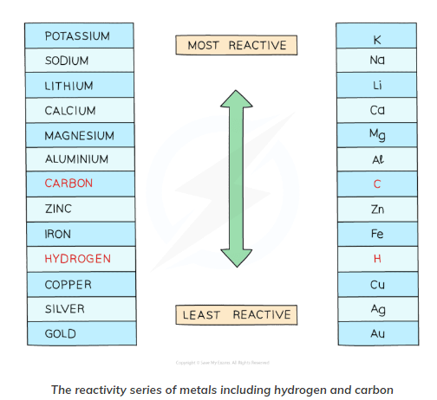

Slide 11
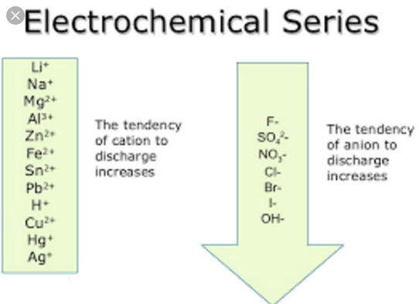

Slide 12
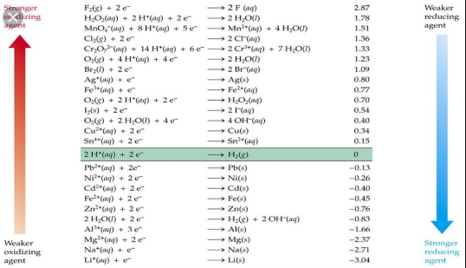

Slide 13
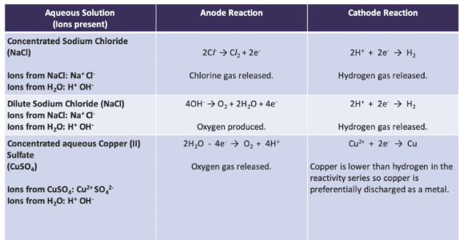

Slide 14
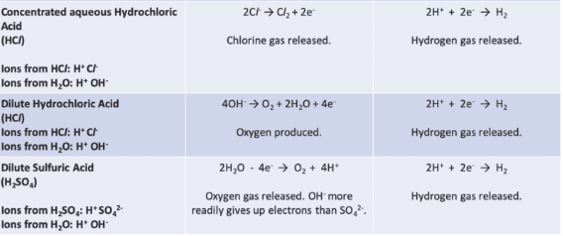

Slide 15
Faraday’s First Law of Electrolysis
Faraday’s First Law of Electrolysis states that the chemical deposition due to the flow of current through an electrolyte is directly proportional to the quantity of electricity (coulombs) passed through it.
i.e. mass of chemical deposition:
Where, Z is a constant of proportionality and is known as electro-chemical equivalent of the substance.
If we put Q = 1 coulombs in the above equation, we will get Z = m which implies that electrochemical equivalent of any substance is the amount of the substance deposited on the passing of 1 coulomb through its solution. This constant of the passing of electrochemical equivalent is generally expressed in terms of milligrams per coulomb or kilogram per coulomb.

